Slide 1
Hello world!
I AM Anmol Sharma
Roll No. 20BPH010
Year :- 3rd (6th sem )
Electrical Engineering
Seminar
EE-329

Slide 2
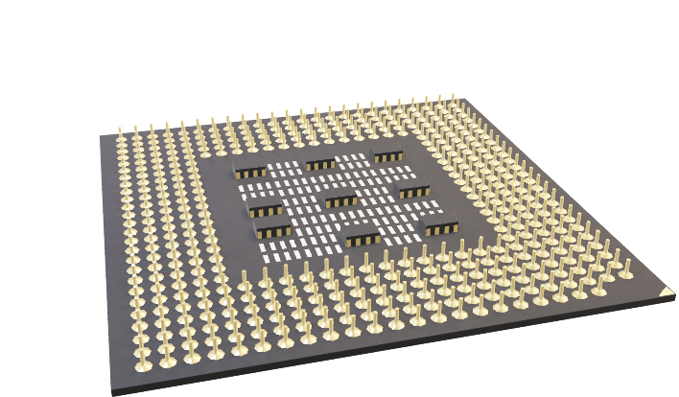
Use of FPGA in High Frequency Trading

Slide 3
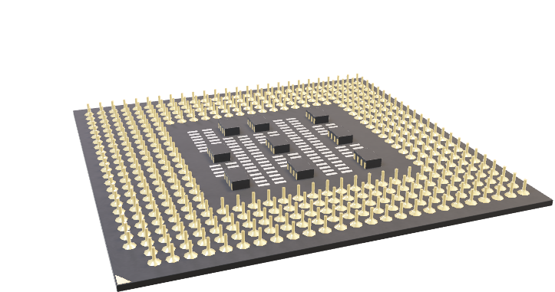
Field Programmable Gate Array
1
Let’s start with the fpga

Slide 4
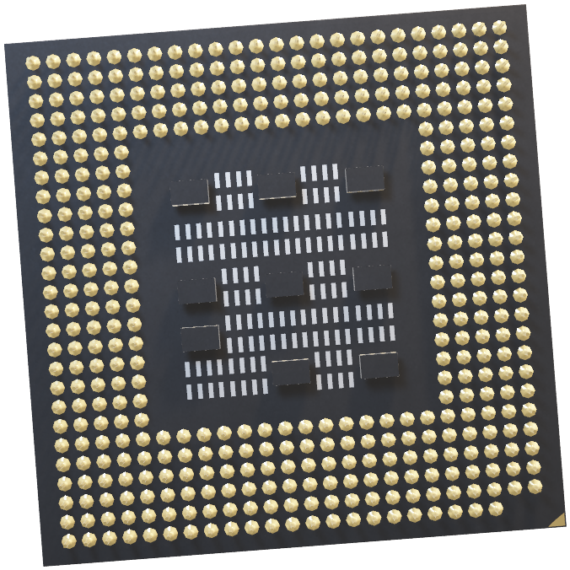
What is FPGA?
FPGA stands for Field-Programmable Gate Array.
It is an integrated circuit that can be programmed by a user to perform specific functions.
Unlike other types of integrated circuits, such as microprocessors or ASICs (application-specific integrated circuits), which are designed for a specific purpose, FPGAs can be configured by the user to perform a wide range of tasks.
Notes:
Field programmable – Once deployed in field for a particular usage In field then we can reconfigure it on the fly
Gate Array- It is an array of logical gate

Slide 5
High frequency Trading
2
Deeper dive into trading
world

Slide 6
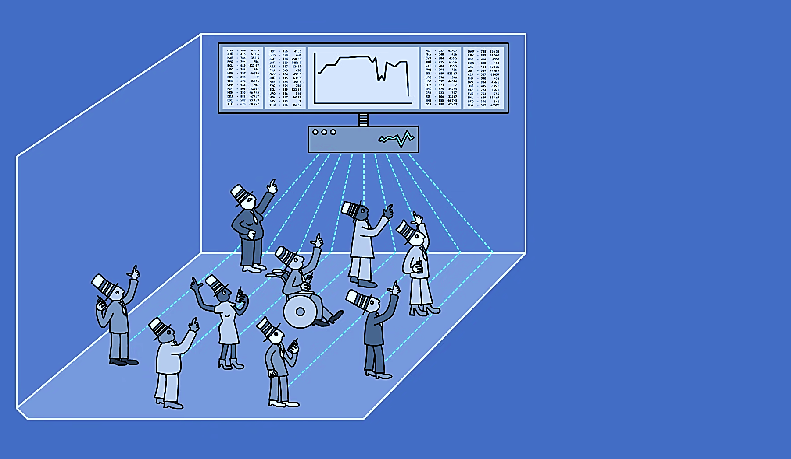
What was Trading?
Earlier trading was like this picture. Bunch of people looking at same data and competing for prices to buy shares

Slide 7
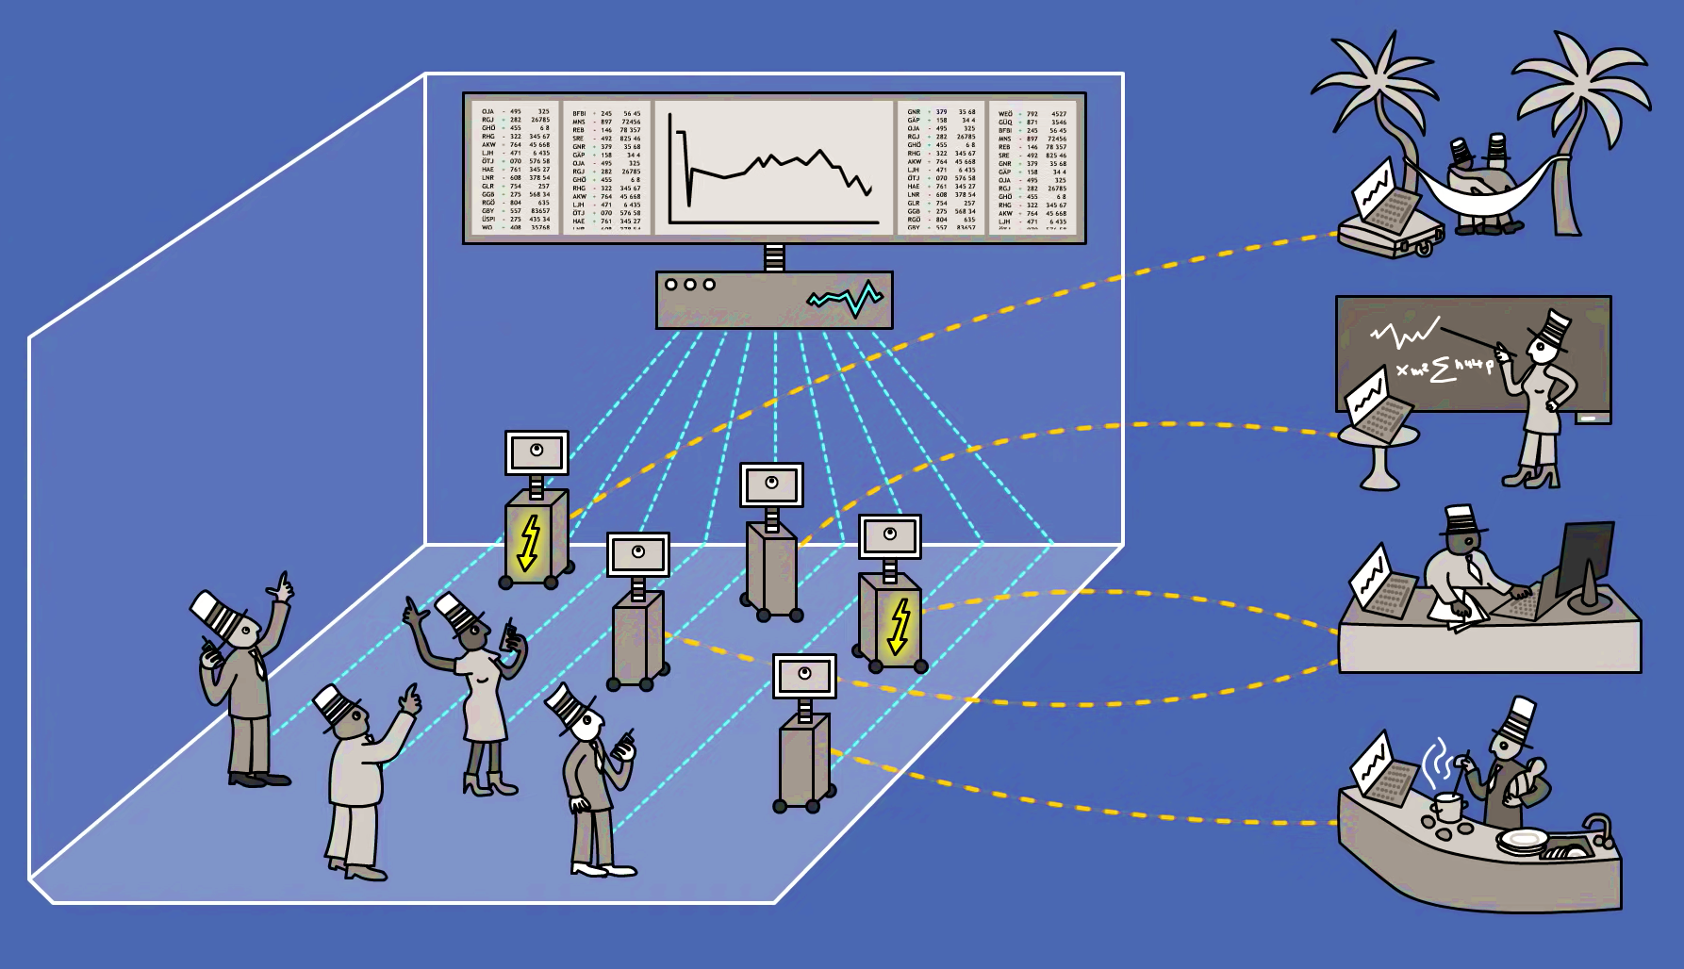
What is High Frequency Trading?
Computers and specialized systems have taken place after implementation of pure electronic trading

Slide 8
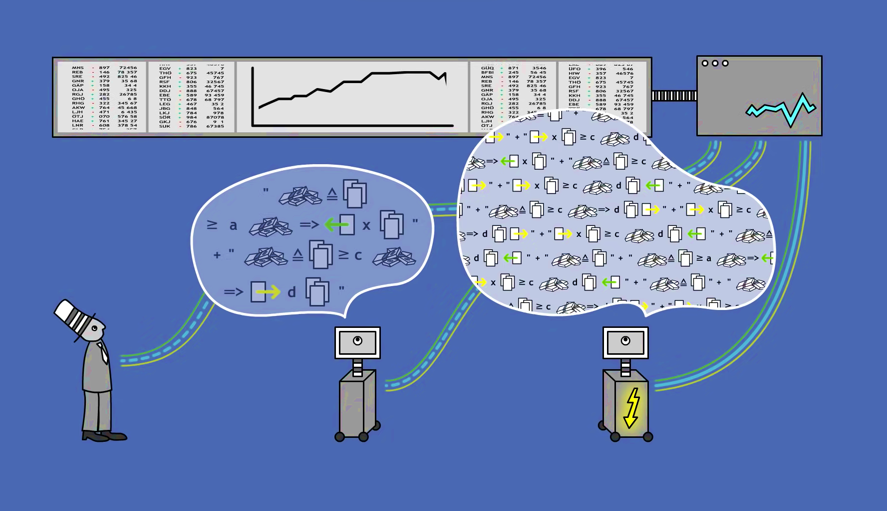
Where FPGA comes in HFT?
To gain extra advantage over other systems, specially designed and programmed systems are deployed

Slide 9
Fraction of High frequency traders in contrast

Slide 10
Volume distribution of trades

Slide 11
Key Features rooting for use in HFT
Customizability
Parallelism
Low power consumption
Real Time processing
Error correction
Notes:
Quote stuffing to gain pricing edge over competition- Placing large amount of orders in very short span of time to inflate price then cancelling instantly in short time then selling existing stock

Slide 12
Conventional Software based trading
CPU
NIC
PCIE
Memory
Exchange
Trading Server

Slide 13
FPGA accelereated trading
CPU
FPGA
PCIE
Memory
Exchange
Trading Server

Slide 14
Building Blocks
FPGA
MAC
Market Data Handeling
Market Data
CPU
Trading
Logic
FPGA
PCIE
Memory
MAC
TCP
Order Formatting
Order Entry
PCIE
Notes:
Quote stuffing to gain pricing edge over competition- Placing large amount of orders in very short span of time to inflate price then cancelling instantly in short time then selling existing stock

Slide 15
Building Blocks
FPGA
MAC
Market Data Handling
Data comes in form of packets
Network Header
Protocol information
Filter to only select subset of data
Market Data
CPU
Trading
Logic
FPGA
PCIE
Memory
MAC
TCP
Order Formatting
Order Entry
PCIE
Notes:
Quote stuffing to gain pricing edge over competition- Placing large amount of orders in very short span of time to inflate price then cancelling instantly in short time then selling existing stock

Slide 16
Building Blocks
FPGA
MAC
Market Data Handeling
Market Data
CPU
Trading
Logic
FPGA
PCIE
Memory
MAC
TCP
Order Formatting
Order Entry
PCIE
Notes:
Quote stuffing to gain pricing edge over competition- Placing large amount of orders in very short span of time to inflate price then cancelling instantly in short time then selling existing stock

Slide 17
Building Blocks
FPGA
MAC
Market Data Handeling
Market Data
CPU
Trading
Logic
FPGA
PCIE
Custom algorithmic logic to process downstream of
trading packets such as
If(packet.transfer_id.price>=‘$10’){
initiateTransaction();
}
Memory
MAC
TCP
Order Formatting
Order Entry
PCIE
Notes:
Quote stuffing to gain pricing edge over competition- Placing large amount of orders in very short span of time to inflate price then cancelling instantly in short time then selling existing stock

Slide 18
Building Blocks
FPGA
MAC
Market Data Handeling
Market Data
CPU
Trading
Logic
FPGA
PCIE
Memory
MAC
TCP
Order Formatting
Order Entry
PCIE
Notes:
PCIE – peripheral components interconnect express – used here for
Order formatting – Used for formatting trade order in compliance with exchange
TCP – robust state management – if request not acknowledged then buffer and window shifting

Slide 19
Target design for FPGA
Minimized piplining
Custom IP
Cutting edge architecture
Robust FPGA system

Slide 20
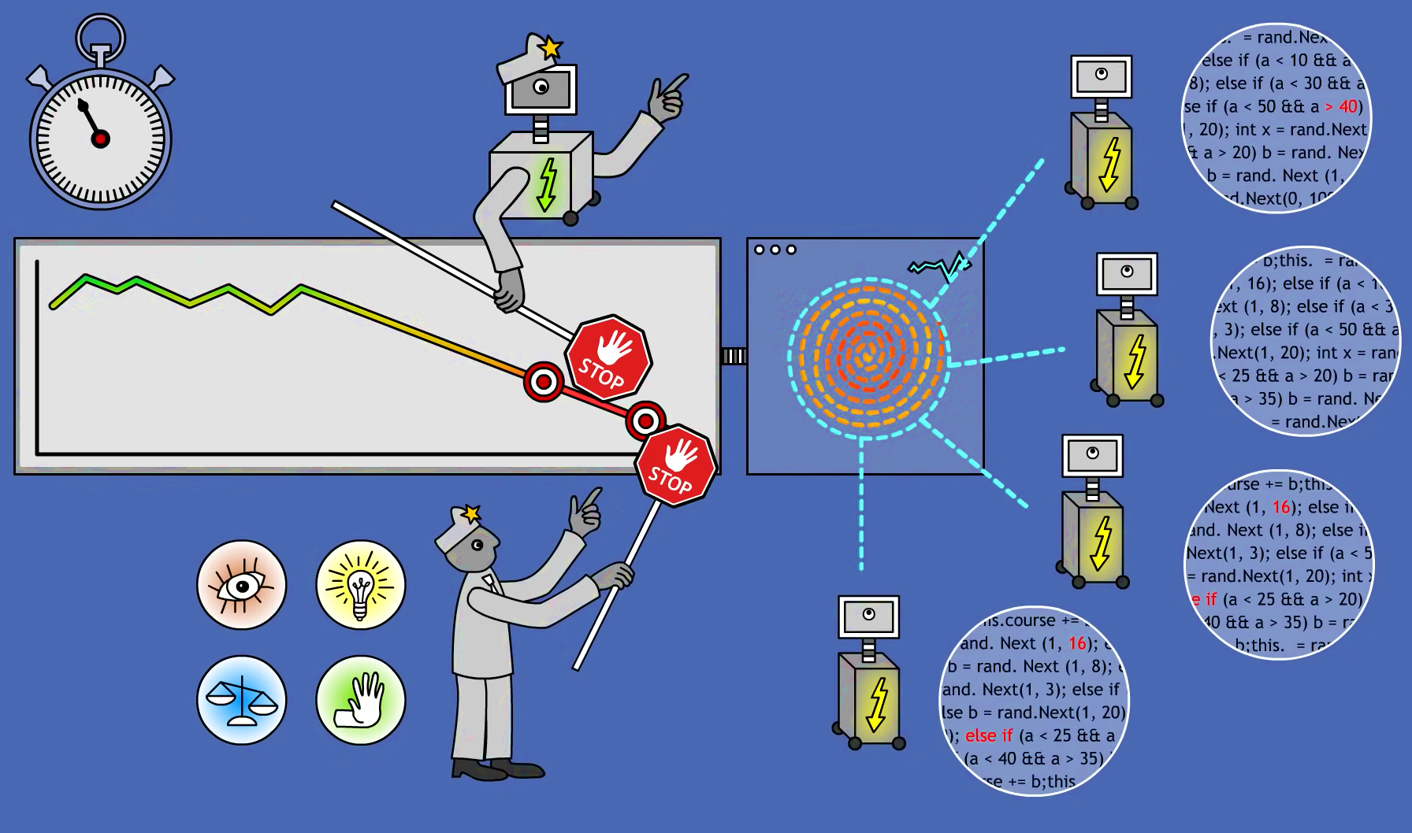
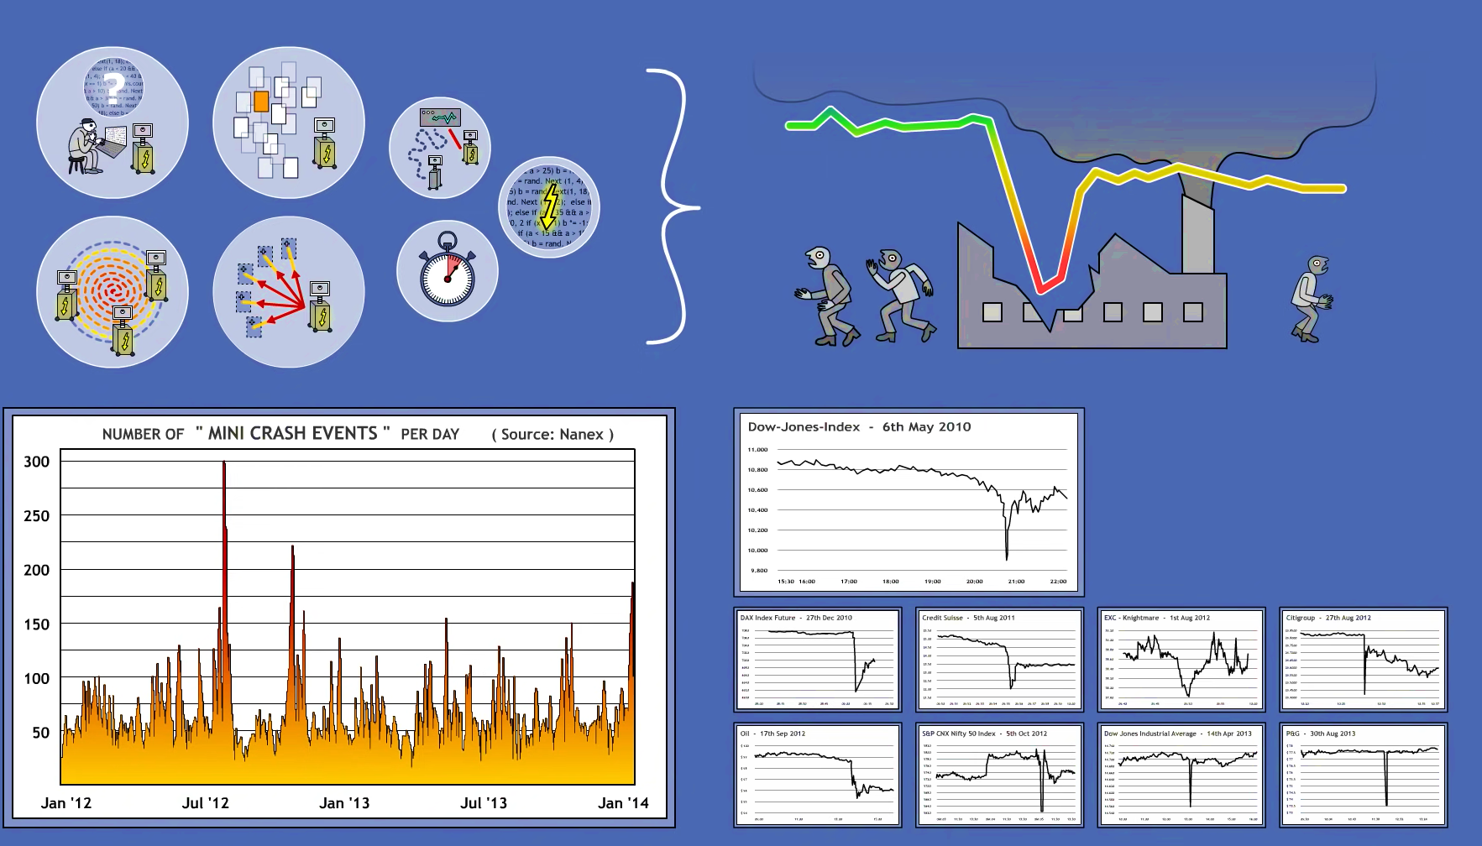
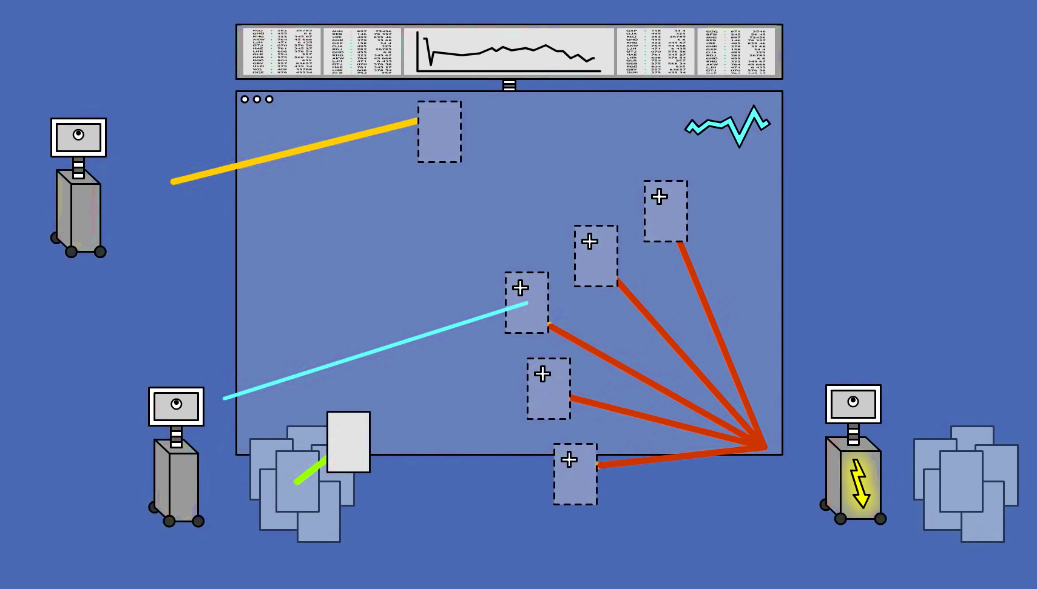
Downsides
Spiral down trend
Flash Crash
Market Exploitation

Slide 21
Downsides
Spiral down trend
Flash Crash
Market Exploitation

Slide 22
Downsides
Spiral down trend
Flash Crash
Market Exploitation

Slide 23
Downsides
Flash Crash
Flash Crash
Market Exploitation

Slide 24
Downsides
Spiral down trend
Flash Crash
Market Exploitation

Slide 25
Downsides
Spiral down trend
Flash Crash
Market Exploitation

Slide 26
In 2010, DJIA fell 1000 points due to algorithmically caused flash crash
Notes:
Down jones industrial average
$1 trillion equity evaporated within minutes

Slide 27
General Preventive methods
Cost per option order
Market wide
Circuit
Breakers
Rate limiting

Slide 28
89,526,124
Volume traded across globe using HFT every minute

Slide 29
Thanks!
ANY QUESTIONS?

